Slide 1
Announcements
Final prep page up
Office hours (34hrs total)
Past exams
Exam specifics
Practice Final (optional)
1pt EC on final
Due 5/10
Project 5
Optional (drop lowest)
Due 5/9 at 5pm

Slide 2
Announcements
Having your Final Exam count for MT1
Survey will go out where you can update your preferences if you have changed your mind since the original survey
Post-final-exam-endgame
Final exam regrade requests + grade report fact checking on Sunday 5/18

Slide 3
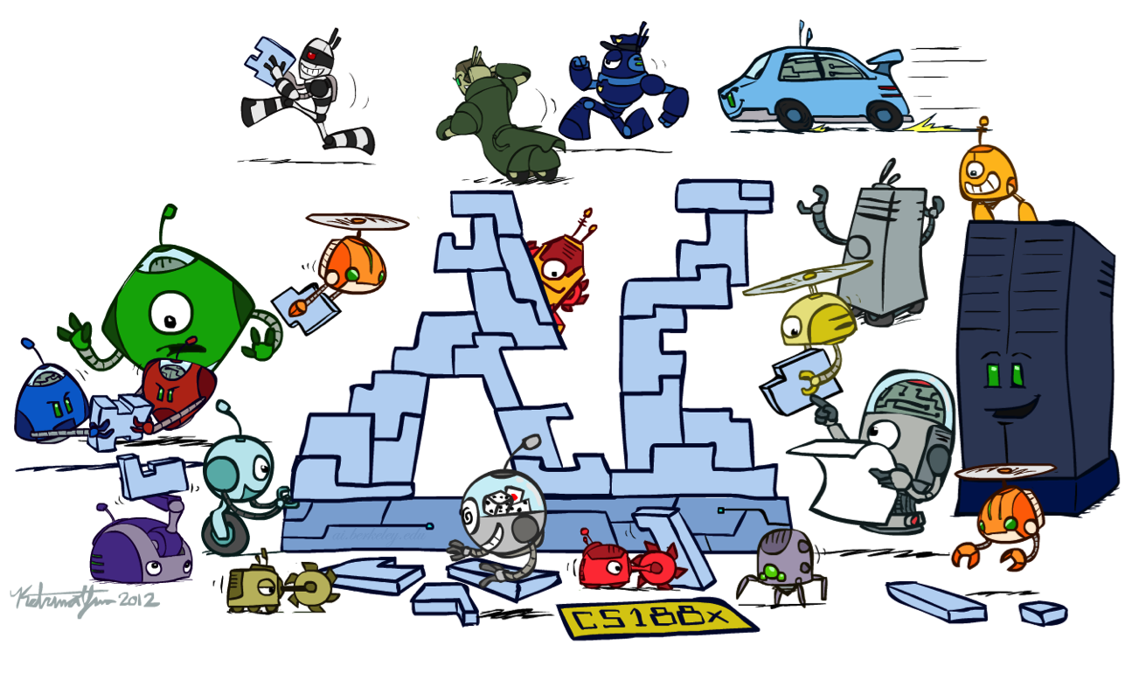
CS 188: Artificial Intelligence
Conclusion
Instructors: Dan Klein and Pieter Abbeel --- University of California, Berkeley
[These slides were created by Dan Klein and Pieter Abbeel for CS188 Intro to AI at UC Berkeley. All CS188 materials are available at http://ai.berkeley.edu.]
Notes:
Please retain proper attribution, including the reference to ai.berkeley.edu. Thanks!

Slide 4
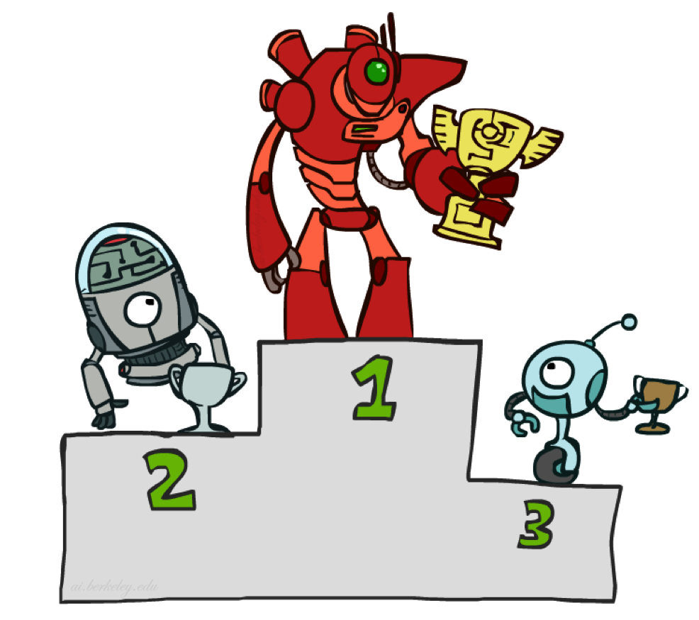
Contest Results

Slide 5
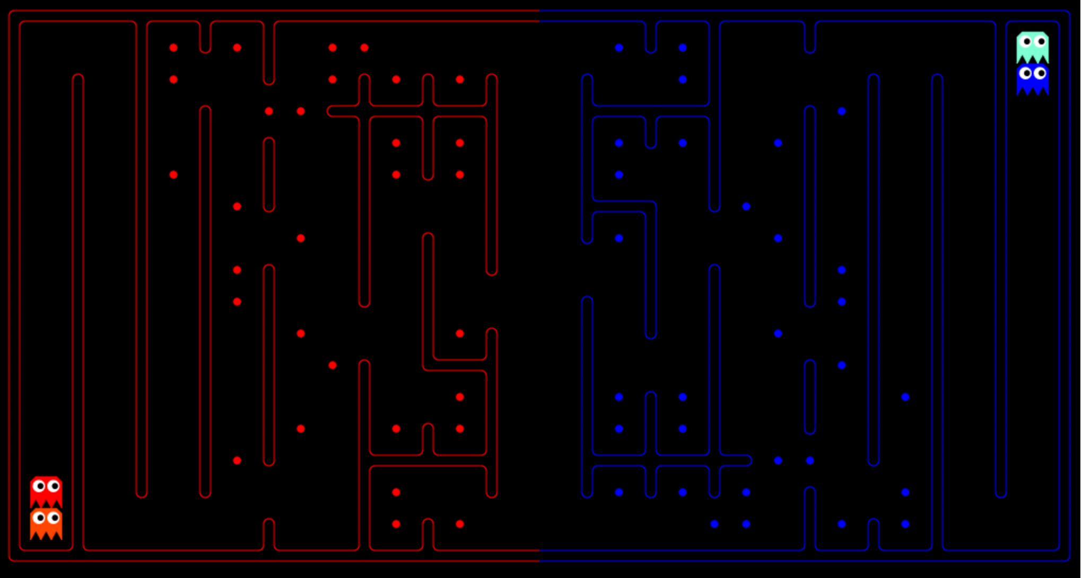
P1 Mini-Contest Results!

Slide 6
P1 Mini-Contest Results
1st place:
Zephyr – Kevin Casey and Zeyu (Andrew) Liu
2nd place
Artificially.Retarded – Fan Ye and Tianhao Zhang
3rd place
Tooskoolforkool – Austen Satterlee

Slide 7
P2 Mini-Contest Results!

Slide 8
P2 Mini-Contest Results
1 [1815] ^_^ Alex Sawai and Zaheen Aziz
[1737] Staffodil Staff
2 [1692] EvenOurselvesCanNot… Fan Ye and TianHao Zhang
[1676] Staff Infection Staff
[1667] Stapphire Staff
3 [1650] 89temples.exe Joseph Hui and Alan Yao

Slide 9
P3 Mini-Contest Results!

Slide 10
P3 Mini-Contest Results
1 [1760] aisaka-taiga Joseph Hui and Kevin Casey
[1747] Staffodil Staff
2 [1721] BOTS… Keonhwa Song and Young Seong Kim
3 [1704] Catch me if you can Fan Ye and Tianhao Zhang

Slide 11
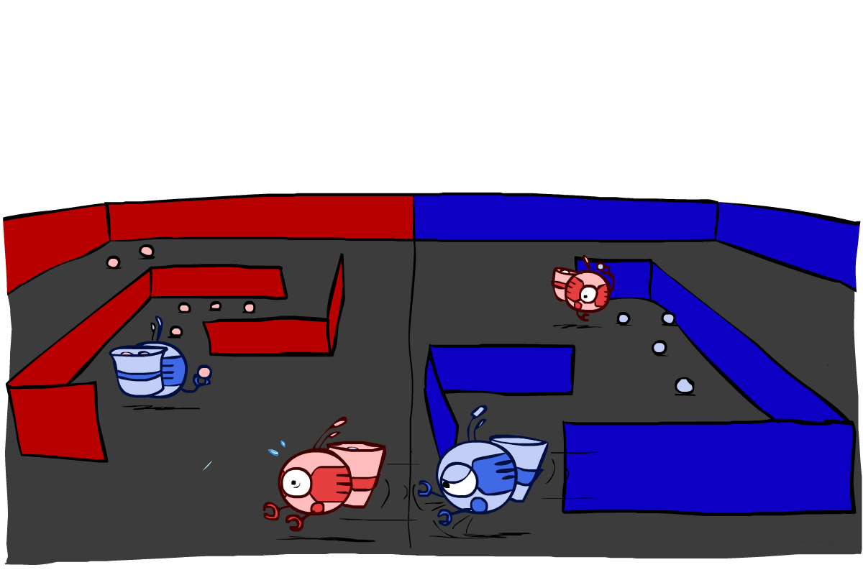
Final Contest

Slide 12
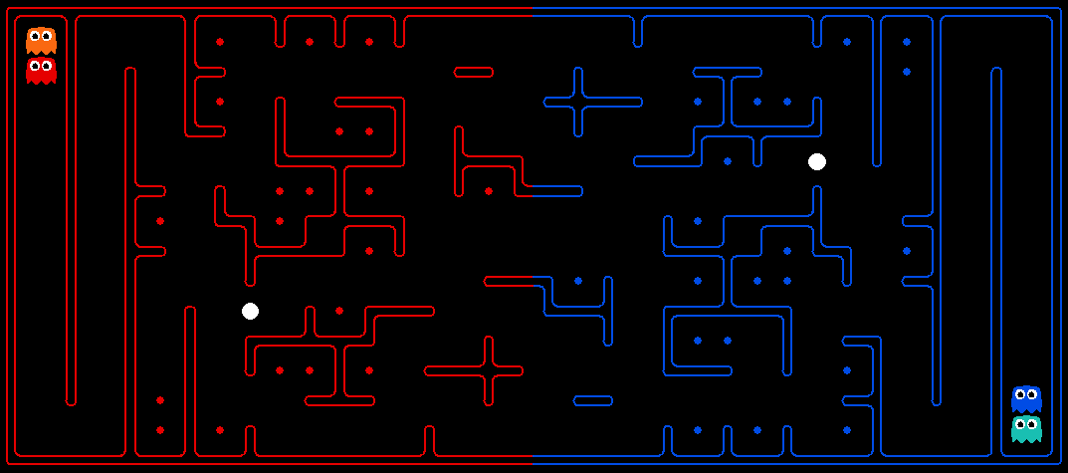
Final Contest Results!
Challenges: Long term strategy, multiple agents, adversarial utilities, uncertainty about other agents’ positions, plans, etc.

Slide 13
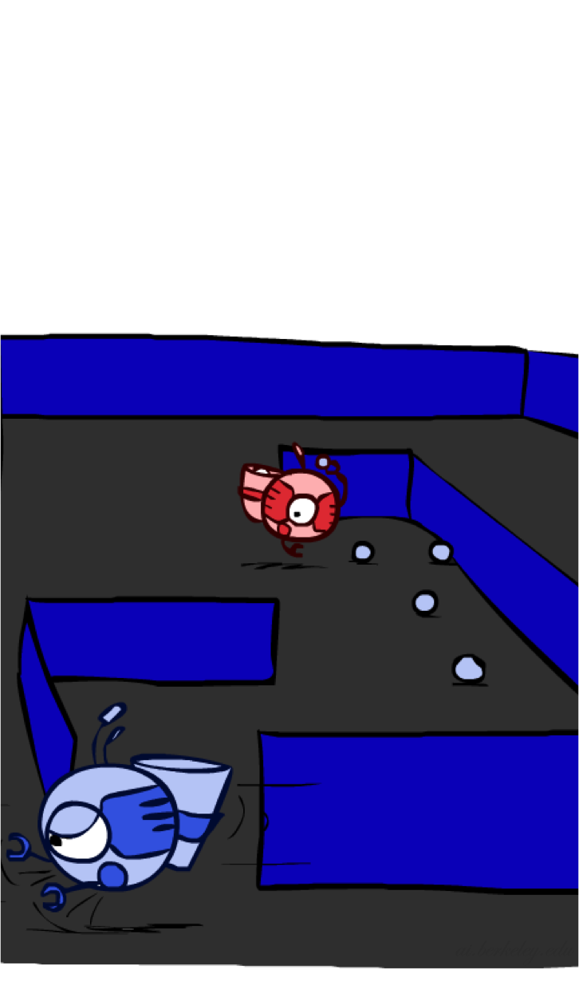
Final Contest Statistics
24 teams, thousands of matches!
Naming trends:
Creative names:
best baseline evar
~ An instructor (Pieter Abbeel) thinks this is an ok bot ~
Touch My Botty, Put Me On The Floor, Wrestle Me Around, Play With Me Some More
Clear intent names:
Uninstall
placeholder
Great work by everyone!
Final results: now

Slide 14
Top-10
4v9vaivaehjvaekfaiufecadfdiofudsoiufoisfdoiufsdasfdaiuofsdaoiusfdaoiufsdaouifsa]yfsa]yaevwyuavbuaewbiuaewrbyuieyurfbyufbyrwyuerwahyuoawchioucfeaouievouiy58avzdkjgfegf3yufoia3w8fgufieaouogifweaugoifeawouiefwabi]uvaoiuvaoiurvrvbywevivr]ivrabuivry]roebyivubo
[1657] Staffy Duck Staff
[1651] Staffeinated Blitzbot Staff
[1616] Staffosaurus Rex Staff
4 [1611] Begierde des Zauberer Alexander Irpan and Sumeet Jain
5 [1610] 4v9vaivaehjvaekfaiufecadfdiofudso … James Maa and Kyle Ong
6 [1594] werr234 Rohan Chitnis and Harrison Wang
[1587] Stapphire Staff
7 [1521] Several Stupid Squirrels Swallowed Some Superfluous Siracha Sauce--Sean Hickey
8 [1496] try Boy Chen
9 [1462] haikuBot Sumukh Sridhara
10 [1457] [$(1)$] James Wong and Jeffrey Zhang

Slide 15
Top Five Teams
Top 5: M45H1R0N Team Members: Joseph Hui and Kevin Casey
Top 5: screwdriver Team Members: Fan Ye and Tianhao Zhang
Top 5: Touch My Botty, Put Me On The Floor, Wrestle Me Around, Play With Me Some More Team Members: Oliver He and Alec Spencer
Top 5: Staffodil Team Members: staff
Top 5: Staff Infection Team Members: staff

Slide 16
For (not) 3rd Place
screwdriver Team Members: Fan Ye and Tianhao Zhang
VS
M45H1R0N
Team Members: Joseph Hui and Kevin Casey
https://contest.cs188.org/contest_matches/36114

Slide 17
For 1st (and 2nd) place
Touch My Botty … Team Members: Oliver He and Alec Spencer
VS
M45H1R0N
Team Members: Joseph Hui and Kevin Casey
https://contest.cs188.org/contest_matches/35587

Slide 18
Vs Staff
Staffodil Team Members: CS188 Staff
VS
M45H1R0N
Team Members: Joseph Hui and Kevin Casey
https://contest.cs188.org/contest_matches/34195

Slide 19
Top-3
1 [1861] M45H1R0N Joseph Hui and Kevin Casey
2 [1809] Touch My Botty … Oliver He and Alec Spencer
[1769] Staffodil Staff
[1767] Staff Infection Staff
3 [1675] screwdriver Fan Ye and Tianhao Zhang

Slide 20
…and Congratulations to All!
Amazing work by everyone
You should all be proud of what you’ve accomplished!

Slide 21
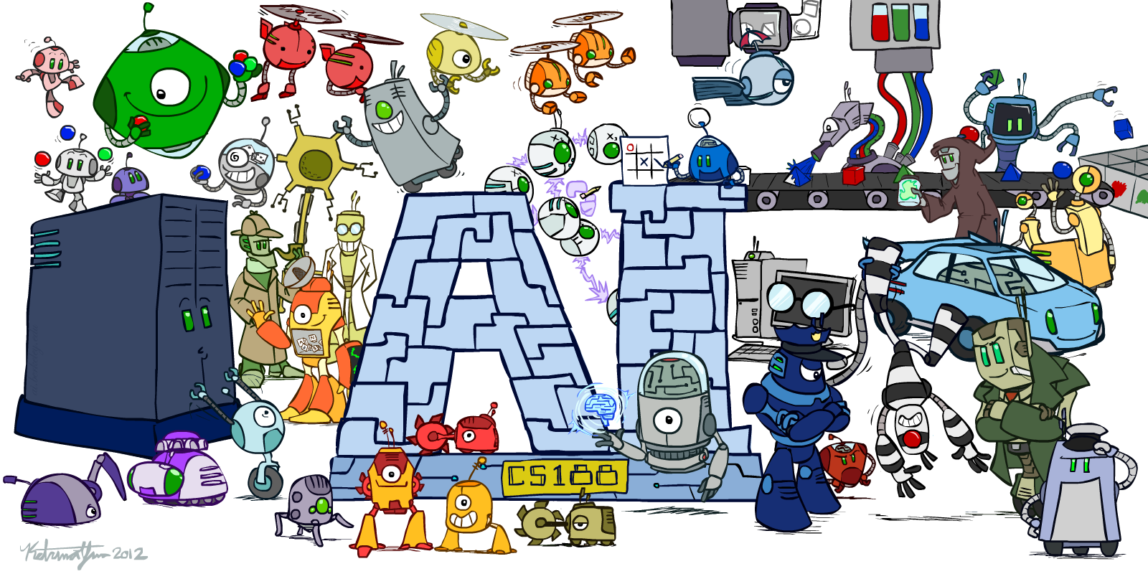

Slide 22

Ketrina Yim
CS188 Artist

Slide 23
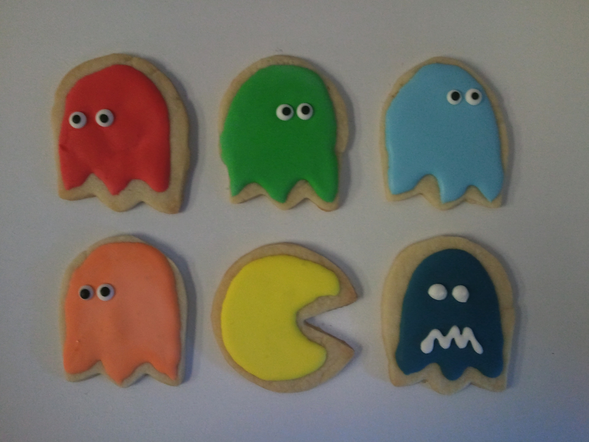

Slide 24

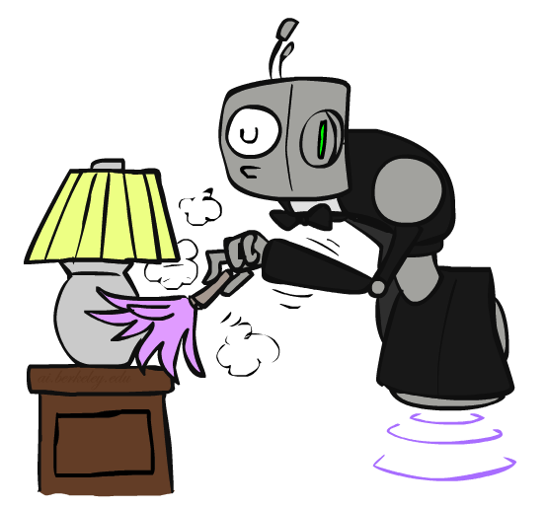
Personal Robotics

Slide 25
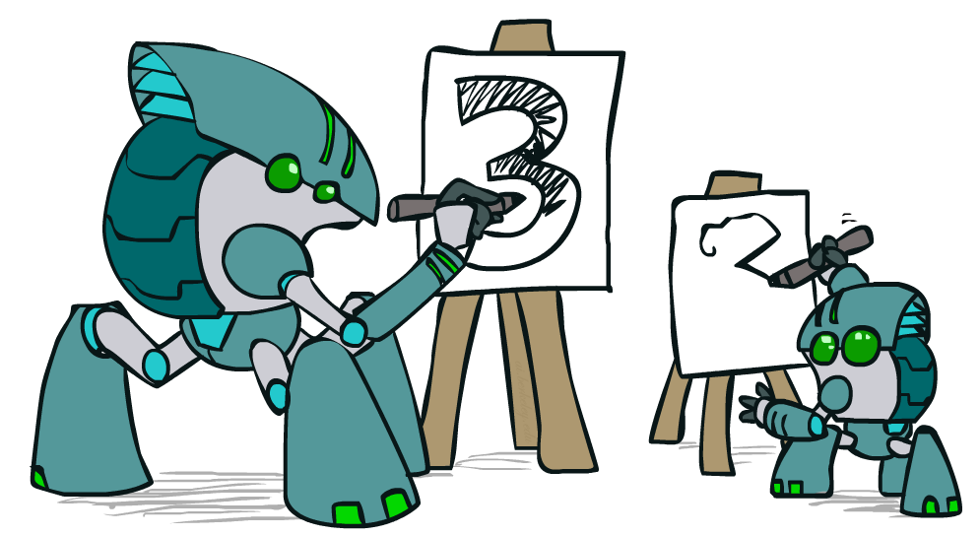
Apprenticeship

Slide 26


Generalizing Trajectories
The problem
Human demonstrated knot-tie in this rope
Robot has to tie a knot in this rope

Slide 27

Cartoon Problem Setting
Train situation:
Test situation:
Demonstration: trajectory
What trajectory here?
?

Slide 28
Cartoon Problem Setting
Train situation:
Test situation:
Demonstration: trajectory
What trajectory here?
Samples of
f : R³ → R³
?

Slide 29
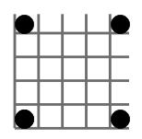
Cartoon Problem Setting
Train situation:
Test situation:
Demonstration: trajectory
What trajectory here?
Samples of
f : R³ → R³
?

Slide 30

Cartoon Problem Setting
Train situation:
Test situation:
Demonstration: trajectory
What trajectory here?
Samples of
f : R³ → R³
?

Slide 31
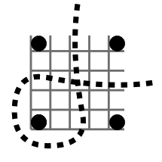

Cartoon Problem Setting
Train situation:
Test situation:
Demonstration: trajectory
What trajectory here?
Samples of
f : R³ → R³

Slide 32
Learning f : R³ → R³ from samples
Observations
Translations, rotations and scaling are FREE
Can be solved efficiently manipulating matrices of size of number of examples

Slide 33
Learning f : R³ → R³ from samples
Solution has form:
Wahba, Spline models for observational data. Philadelphia: Society for Industrial and Applied Mathematics. 1990.
Evgeniou, Pontil, Poggio, Regularization Networks and Support Vector Machines. Advances in Computational Mathematics. 2000.
Hastie, Tibshirani, Friedman, Elements of Statistical Learning, Chapter 5. 2008.

Slide 34
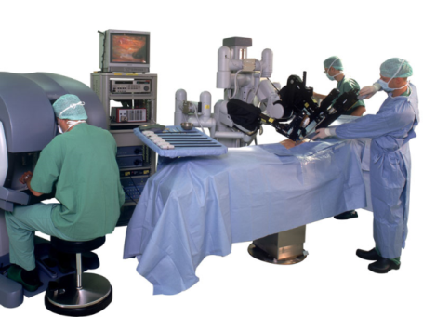

Looking Ahead

Slide 35
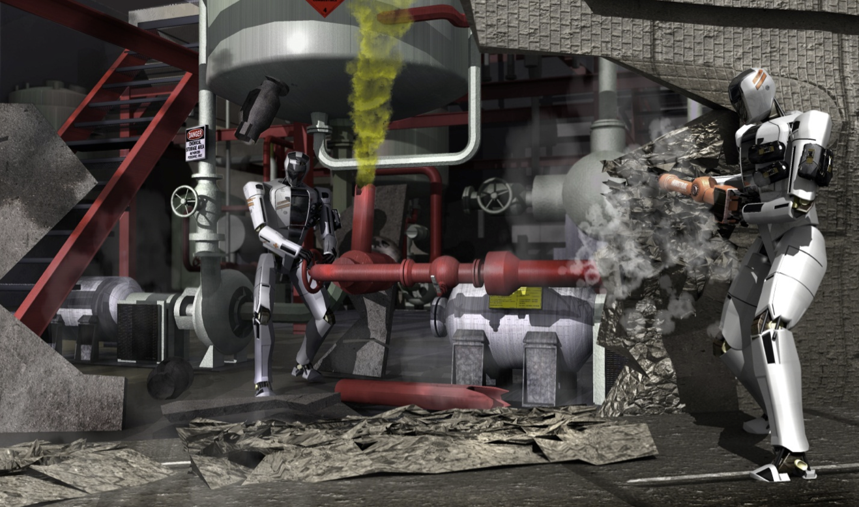
Darpa Robotics Challenge
Disaster response (e.g., Fukushima)
E.g., Get into car, drive it, get out, open door, enter building, climb ladder, traverse industrial walkway, use tool to break a panel, locate and close a valve, replace a cooling pump
Competition / Prizes
Simulation competition: June 2013
Prize: Atlas robot
Semi-final round: December 2013
Real robot (Atlas) competition: Nov. 2014
Prize: $ 2M
Notes:
http://www.wired.com/dangerroom/2012/10/darpa-rescue-robot/

Slide 36
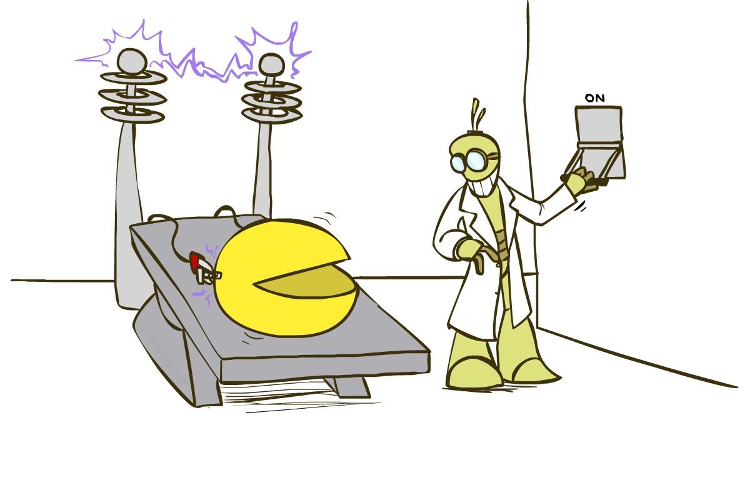
Pac-Man Beyond the Game!

Slide 37
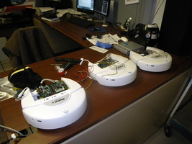
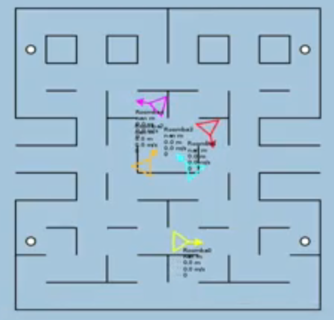

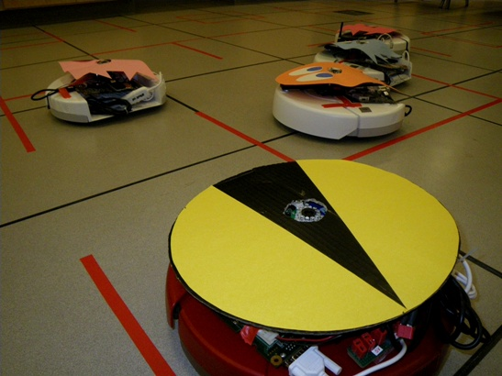
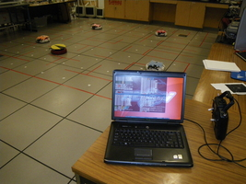
Pacman: Beyond Simulation?
Students at Colorado University: http://pacman.elstonj.com
Notes:
Roomba .flv

Slide 38
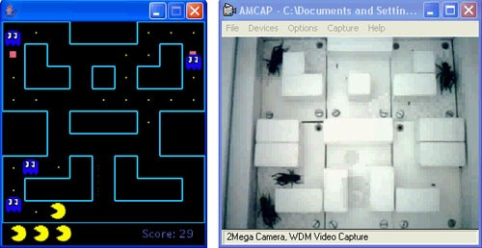
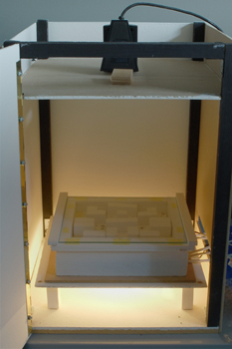
Bugman?
AI = Animal Intelligence?
Wim van Eck at Leiden University
Pacman controlled by a human
Ghosts controlled by crickets
Vibrations drive crickets toward or away from Pacman’s location
http://pong.hku.nl/~wim/bugman.htm

Slide 39
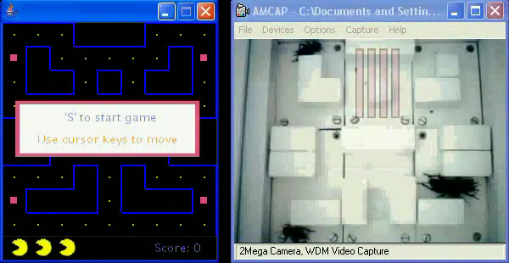
Bugman
[VIDEO: bugman_movie_1.mov]

Slide 40

Where to Go Next?

Slide 41
Where to go next?
Congratulations, you’ve seen the basics of modern AI
… and done some amazing work putting it to use!
How to continue:
Machine learning: cs189, stat154
Intro to Data Science: CS194-16 (Franklin)
Probability: ee126, stat134
Optimization: ee127
Cognitive modeling: cog sci 131
Machine learning theory: cs281a/b
Vision: cs280
Robotics: cs287
NLP: cs288
… and more; ask if you’re interested

Slide 42
That’s It!
Help us out with some course evaluations
Have a great summer, and always maximize your expected utilities!

Slide 43
